Slide 1
Introduction to Deep Learning
Computer Vision

Slide 2
Before Starting the Course
Upon completion of this course, you will have acquired general knowledge of introductory artificial intelligence algorithms and data analysis
Since the specific topics are difficult to understand and it will not be easy for the one to settle the logic during the lesson, a lot of individual practice is required
Slides will be explained with visuals without drowning in texts. That is why it is extremely important to take notes during the lesson
Since the titles are sufficient for basic level algorithms, the titles should be researched, and research should be done on sites that contain plenty of practice and theoretical information

Slide 3
What You Will Learn In This Course
We will make an in-depth introduction to the field of Computer Vision and get to know the concepts of image processing, numerical analysis, and pixel
We will see operations such as Data Augmentation and feature extraction on the image, and learn the concept of a pre-trained model with Transfer Learning
We will meet with the Algorithms used in the field of Computer Vision, we will get to know the frequently used models and activation functions by processing the Convolutional Neural Network architecture with all the details
We will make a quick introduction to the Object Detection and Image Classification fields, which are popular Computer Vision fields, and examine the applications made in these fields, the models used, and the ready data sets

Slide 4
İrem Kömürcü
Github: irem-komurcu
Linkedin: iremkomurcu
Twitter: iremkomurcu

Slide 5


Resources
Deep Learning with Python
Deep Learning with PyTorch

Slide 6
Digital Image Processing and Computer Vision

Slide 7
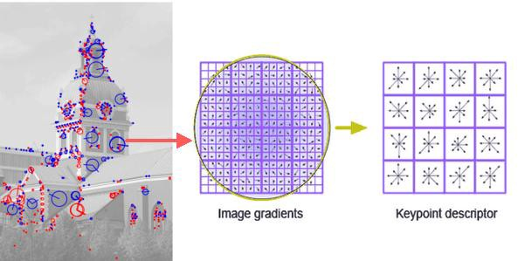
Digital Image Processing and Computer Vision
Digital image processing; It is the realization of image processing on pictures using computer algorithms.
Series of images enters into the system
A Feature Extraction is used to preprocess and extract features from these images
A Machine Learning system uses the extracted feature to train a model and make predictions

Slide 8
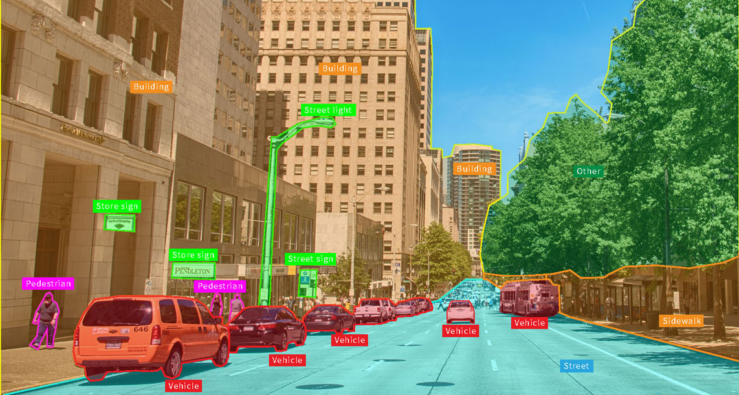
Image Processing
When trying to implement a Computer Vision(CV) system, we need to consider two main components;
Image Acquisition Hardware
Image Processing Software
In fact, our system must be immutable to environmental changes and be able to repeatedly perform its designed task. To meet these requirements, it may be necessary to impose certain restrictions on the hardware or software of our system.

Slide 9
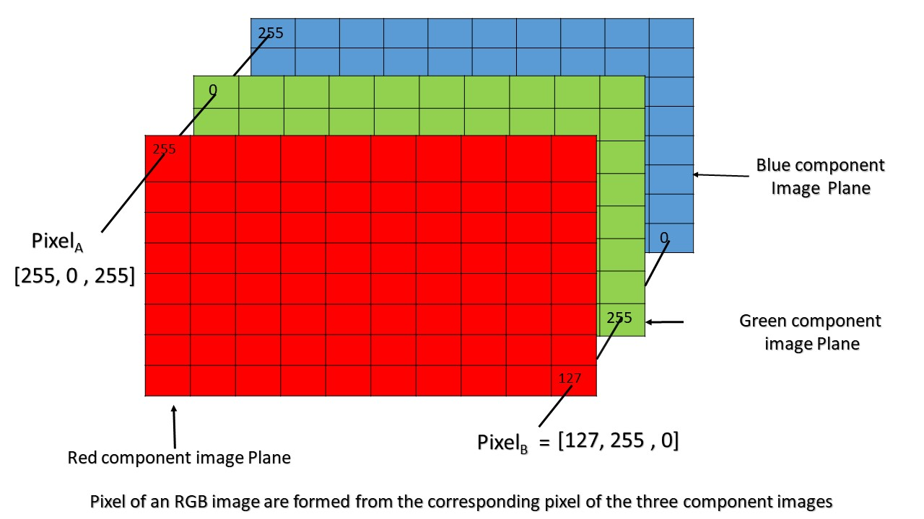
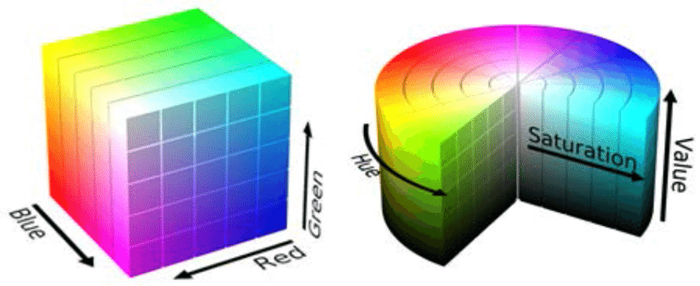
Image Processing and Pixel
An image is obtained from a hardware device. A software system then numerically represents the colors (Color Spaces) within the image.
A pixel is the numerical value of a point in an image.
An image is typically represented as an array of pixels.
Two of the most famous color spaces are RGB (Red, Green, Blue) and HSV (Hue, Saturation, Value)

Slide 10
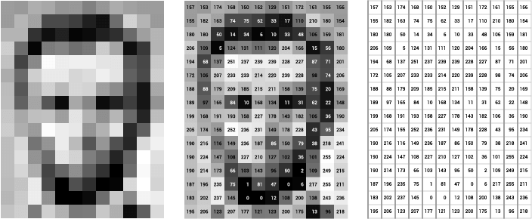
Image Processing
Image processing is considered a sub-topic of digital signal processing.
Sayısal görüntüler ikiden fazla boyutta tanımlanabildiğinden sayısal görüntü işleme çok boyutlu sistemler olarak modellenebilir.

Slide 11
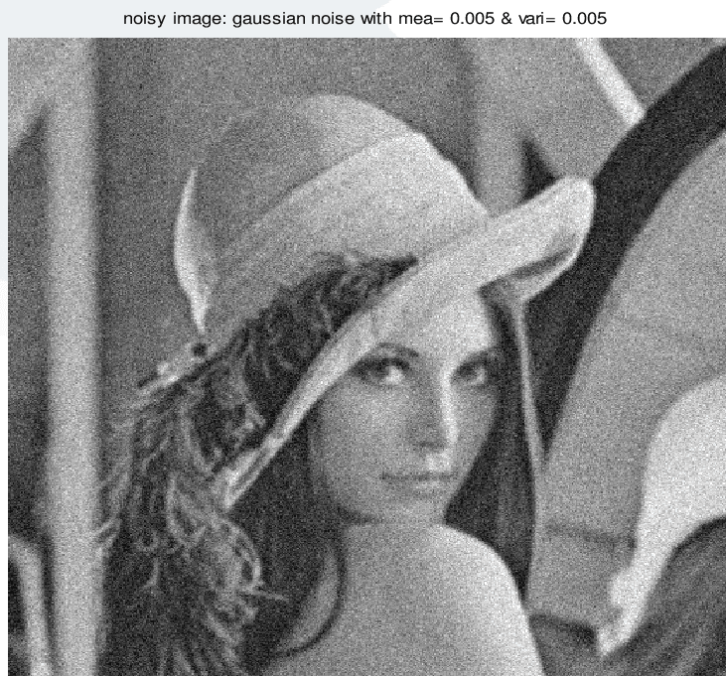
Noise in Signals
In signal processing, noise occurs as a result of undesirable changes that a signal may undergo during processes such as capture, storage, and transmission.
There are many types of noise. To reduce these noises, special filters can be applied to the noise type.
Gaussian noise, which is one of the noise types in the image; at the pixel level, the image is characterized by the Gaussian distribution function and noise is formed.
Notes:
Sinyal işlemede gürültü, bir sinyalin yakalama, depolama, iletim, işleme veya dönüştürme sırasında maruz kalabileceği istenmeyen (ve genel olarak bilinmeyen) değişiklikler için genel bir terimdir.[1]
Bazen bu kelime rastgele (öngörülemeyen) ve hiçbir yararlı bilgi taşımayan sinyaller anlamında da kullanılır; diğer sinyallere müdahale etmeseler veya konfor gürültüsünde olduğu gibi kasıtlı olarak tanıtılmış olsalar bile.
Gürültü azaltma, orijinal sinyalin gürültüden bozulmuş olandan kurtarılması, sinyal işleme sistemlerinin, özellikle de filtrelerin tasarımında çok yaygın bir hedeftir. Gürültü giderme için matematiksel sınırlar bilgi teorisi tarafından belirlenir.
Salt and Pepper Noise
Fixed-Pattern Noise
Gaussian Noise
Shot Noise
Film Grain
Read Noise
Anisotropic Noise
Quantization Noise
Periodic Noise
Branding Noise
Random Noise

Slide 12
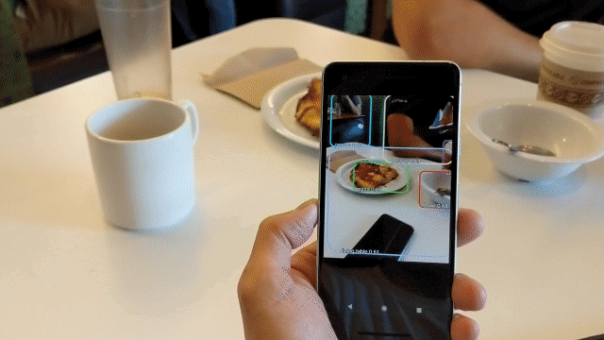
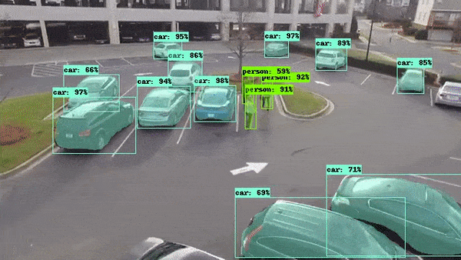
Computer Vision Usage Areas
Autonomous Driving
Social Network Filtering
Camera and Filters
Bioinformatics
Advertising
Image Processing
Health Service
Real-time Sports Tracking
Agriculture
Education

Slide 13
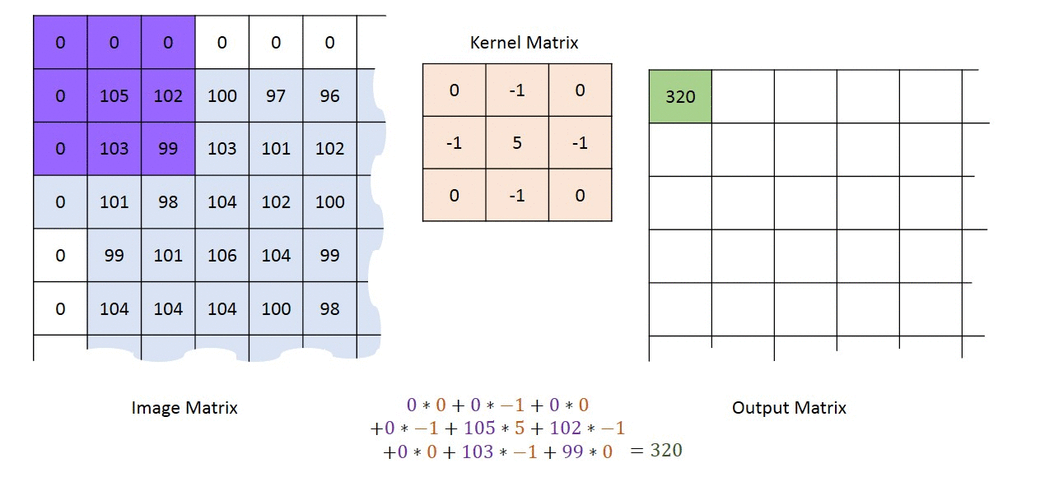
Feature Extraction
Feature extraction works around the idea of extracting useful features that clearly identify objects in an image.
It involves reducing the number of resources required to describe a large dataset, it is dimension reduction.
Notes:
Feature extraction is a process of dimensionality reduction by which an initial set of raw data is reduced to more manageable groups for processing. A characteristic of these large data sets is a large number of variables that require a lot of computing resources to process. Feature extraction is the name for methods that select and /or combine variables into features, effectively reducing the amount of data that must be processed, while still accurately and completely describing the original data set.

Slide 14
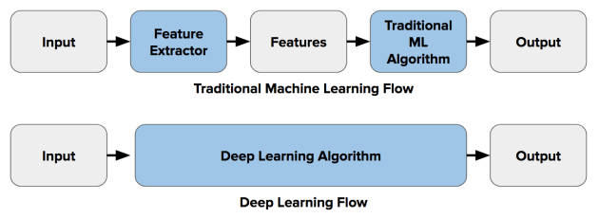
Feature Extraction
Why we use Feature Extraction
Performing analysis with a large number of variables often requires large amounts of memory and computational power
Too many features can increase the complexity of our model, leading to an overfit.
Feature extraction; It defines the data with sufficient accuracy and uses different types of filters to transform it with the image to overcome these problems.

Slide 15
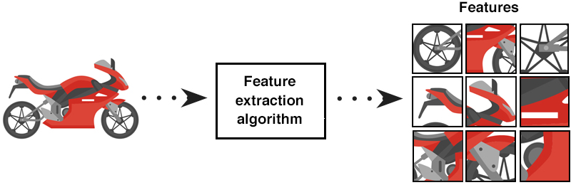
4 Major Morphologies in Feature Extraction
Global Features: The entire image is analyzed as a single feature and a single feature vector is extracted from the feature extractor.
Grid or Block Based Features: The image is divided into different blocks and features are extracted from each of the different blocks
Region Base Features: The image is divided into different regions and a feature is extracted from each of these regions.
Local Features: Multiple points of interest are detected in the image and the pixels adjacent to the points of interest are analyzed to extract features
Notes:
Global Özellikler: Tüm görüntü tek bir özellik olarak analiz edilir ve öznitelik çıkarıcıdan tek bir öznitelik vektörü çıkar.
Izgara veya Blok Tabanlı Özellikler: görüntü farklı bloklara bölünür ve özellikler farklı blokların her birinden çıkarılır.
Bölge Tabanlı Özellikler: görüntü farklı bölgelere bölünür (örn. Eşikleme veya K-Ortalama Kümeleme gibi teknikler kullanılarak ve daha sonra bunları Bağlı Bileşenler kullanılarak segmentlere bağlanır) ve bu bölgelerin her birinden bir özellik çıkarılır.
Yerel Özellikler: görüntüde birden çok ilgi noktası tespit edilir ve ilgi noktalarına komşu pikseller analiz edilerek özellikler çıkarılır. Bir görüntüden çıkarılabilecek ana ilgi noktası türlerinden ikisi köşeler ve lekelerdir, bunlar Harris & Stephens Detector ve Laplacian of Gaussians gibi yöntemler kullanılarak çıkarılabilir.

Slide 16
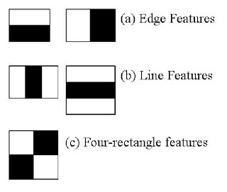
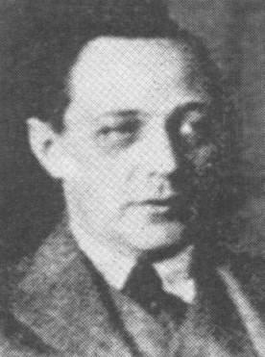
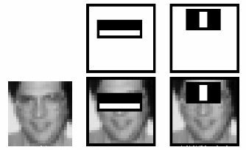
Alfred Haar and Haarcascade Features
Haar-like Features:
Edge Properties; If a certain area on the image consists of dark areas and a certain area consists of light colors, it indicates an edge feature.
Line Properties; If the image consists of light, dark and light colors, respectively, it has a line feature.
Four Square Properties; If dark and light tones are diagonally in a square shape, it indicates four square features.
Notes:
bkz. Haar Dalgacik Donusumu

Slide 17
Convolutional Neural Network
CNNs

Slide 18

Convolutional Neural Network
Simple Convolutional Neural Network Notation

Slide 19
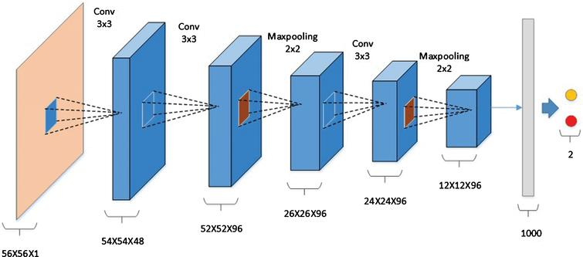
CNN and Layers
CNN layers;
Convolutional Layer
Non-Linearity Layer
Pooling
(Downsampling Layer)
Stride
Padding
Flattening Layer
Fully-Connected Layer

Slide 20
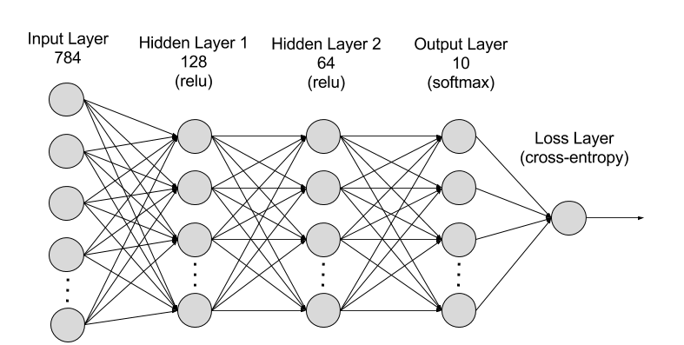
Input Layer
The input layer in CNN should contain the image data. Image data is represented by a multidimensional matrix and reshaped into a single vector within the input layer.
For example, you have a 28x28 image. This image is converted into a 784x1 vector as 28x28=784 before processing.
If you have m training samples, your size will be 784xm.

Slide 21


Slide 22

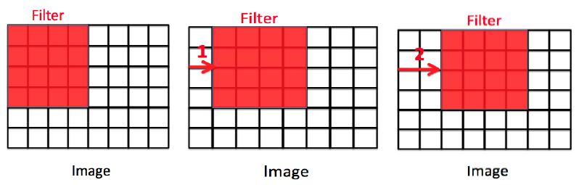
Stride
We express the number of rows and columns covered per shift as stride.
The number of stride does not have to be one. Sometimes, either for computational efficiency or because we want to downsample, we move our window multiple items at once, bypassing intermediate positions.
Notes:
Çapraz korelasyonu hesaplarken, giriş tensörünün sol üst köşesindeki evrişim penceresiyle başlamak ve ardından onu tüm konumlar üzerinde hem aşağı hem de sağa kaydırmak bir adım

Slide 23
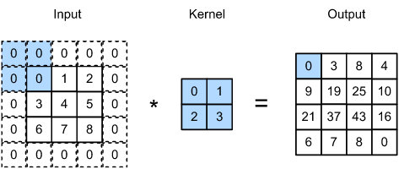
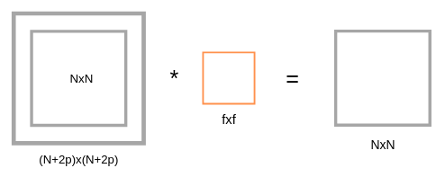
Padding
One problem with applying convolutional layers is that we tend to lose pixels around our image.
Especially when we apply many sequential convolution layers, pixel losses can be experienced intensely.
A simple solution to this problem is to add extra padding pixels around the border of our input image, thus increasing the effective size of the image.
Notes:
filtremiz görüntümüz üzerinde öznitelik çıkartmak için gezinirken, bazı pikselleri diğer piksellere göre daha fazla işleme sokar.
Bu da daha fazla işleme sokulan kısımların daha çok öğrenilmesini

Slide 24

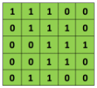
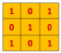
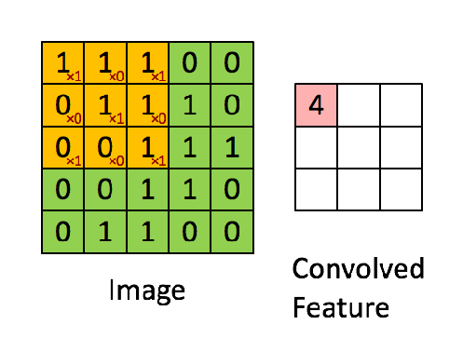
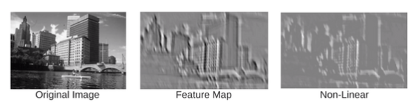
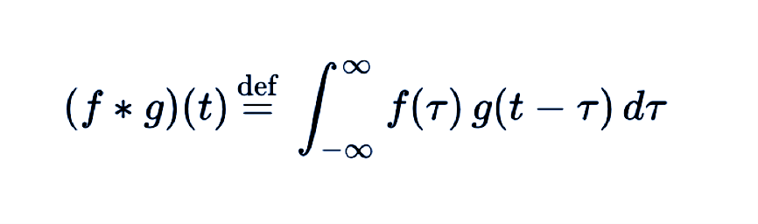
Convolution Layer
The convolution layer (CONV) uses filters that perform convolution operations while scanning the input layer by size.
The resulting output is called the feature map or activation map.
In mathematics, and especially in functional analysis, a convolution is an integral operation that shows how the shape of one function is modified by another function.

Slide 25
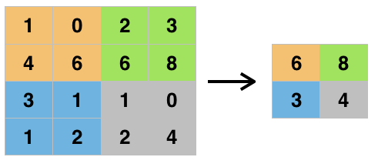
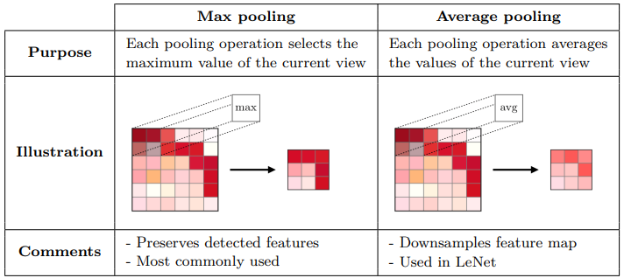
Pooling Layer
It is used to reduce the size of feature maps. Thus, it reduces the number of parameters to be learned in the network and the amount of calculations made.
Havuzlama katmanı, Konvolüsyon sonrası özellik haritasının özelliklerini özetler.
Maximum pooling takes the maximum values, while Average pooling takes the average values.
Notes:
bu da computation sırasında hız ve kaynak maliyetini optimize eder.

Slide 26

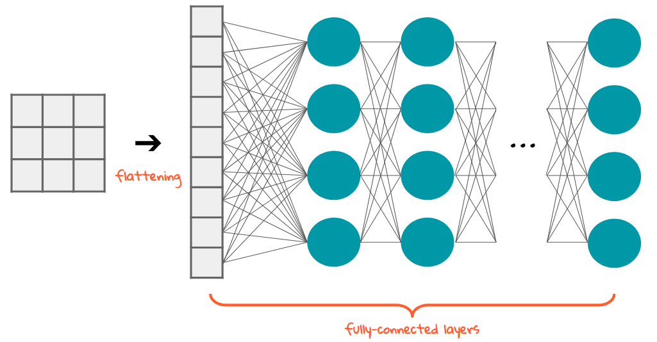
Flattening Layer
Once the Feature Map is obtained, the next step is to flatten it.
Flattening involves converting the entire pooled feature map matrix into a single column and feeding the neural network for further processing

Slide 27
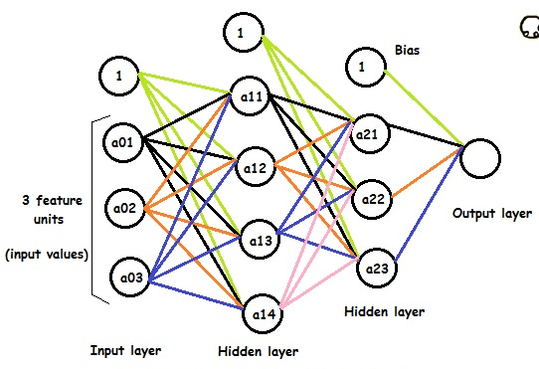
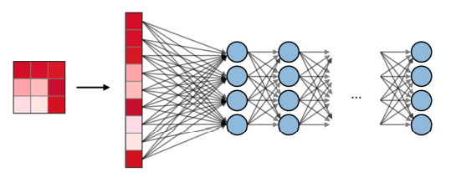
Fully Connected Layer
A fully connected layer (FC) is a layer where all inputs in one layer are connected to each unit of the next layer. It is a standard neural network layer.
Fully connected layers can be used to optimize goals such as class scores.
The biggest advantage of fully connected layers is; They are structure independent. No special assumptions to be made about the input

Slide 28
Commonly Used Activation Functions

Slide 29
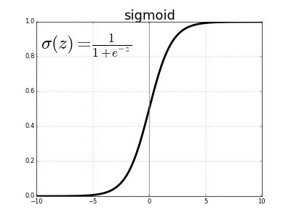
Sigmoid Function
It is a non-linear function. The value range of this function, which has a probabilistic approach to decision making, is between [0,1].
Changes in the x value in these functions will cause serious changes on the y value
No matter how much x changes between (-infinity, +infinity) the activation value will always be between 0 and 1

Slide 30
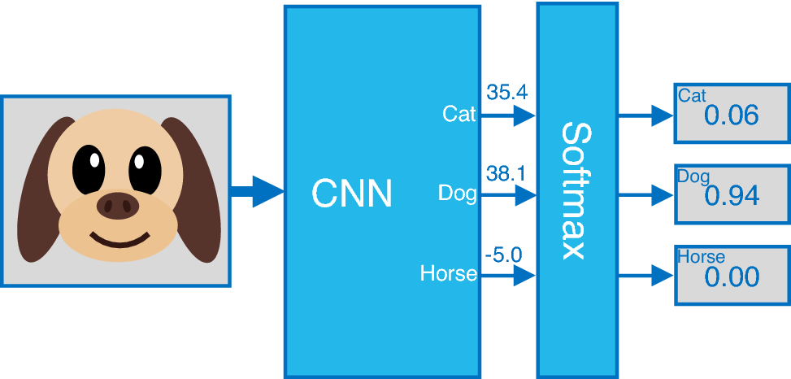
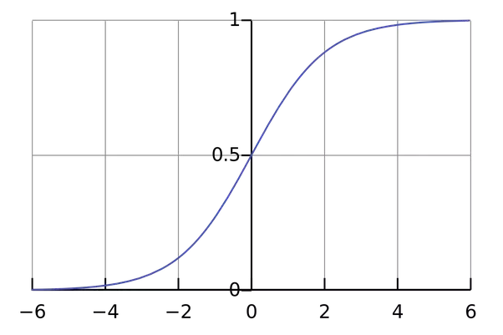
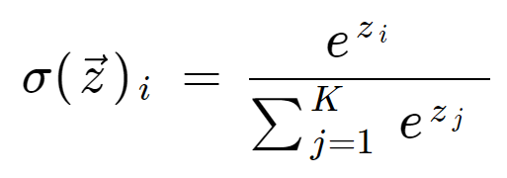
Softmax Function
Softmax returns a probability result for each class as output in a multi-class classification problem.
For multi-class operations your network should end with a softmax activation function so it will give a probability distribution over N output classes.

Slide 31
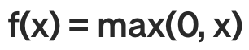
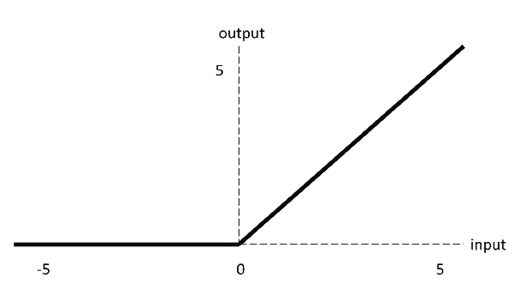
ReLU (Rectified Linear Unit)
ReLU is an activation function that returns 0 for negative values and the value itself for positive values.
ReLU includes simpler mathematical operations compared to tanh and sigmoid, thus further improving computational performance.
ReLU is used as a solution to the Vanishing Gradient problem as it does not produce small outputs.

Slide 32
What is a Pre-Trained Model?

Slide 33
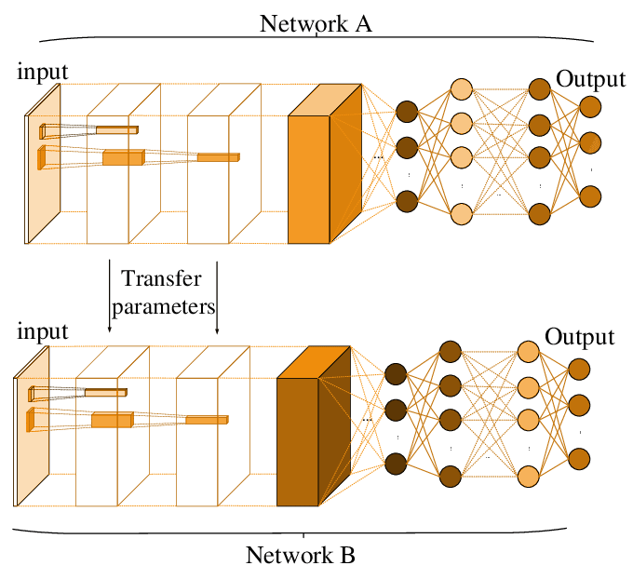
What is a Pre-Trained Model?
A pre-trained model is a registered network that has been previously trained on a large dataset, typically a large-scale image classification task. You either use the pre-trained model as is, or you use transfer learning to customize this model for a specific task.
xception
Inception V3
ResNet50
VGG16
VGG19
MobileNet
All listed models are pre-trained on the ImageNet dataset

Slide 34
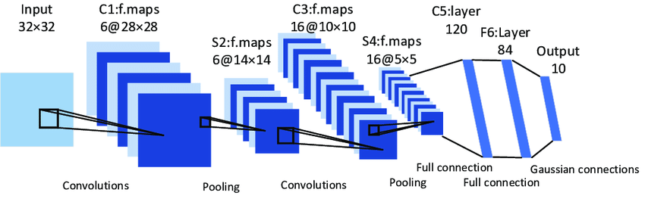
LeNet-5
Yann LeCun and his team published an article in 1998, explaining how image processing methods can be used on Deep Networks. This structure, called LeNet-5, was the first successful Convolutional Neural Network.
Unlike other models, LeNet-5;
During the pooling phase, it performs average-pooling instead of max-pooling
Sigmoid and hyperbolic tangent are used as activation functions
Notes:
sigmoid bizim için 2 çıkışlı, 0 ya da 1

Slide 35
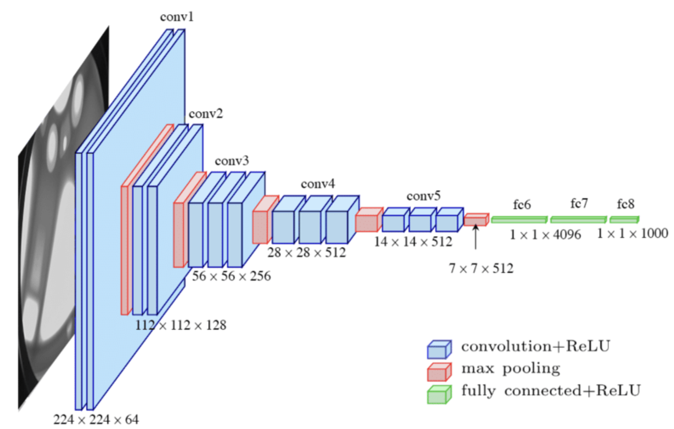
VGG16
It is a simple network model and the most important difference from other networks is the use of 2 or 3 convolution layers
Calculates 1000 class softmax performance on two FC layer outputs
Approximately 138 million parameter calculations are made
As in other models, while the height and width dimensions of the matrices decrease from the input to the output, the depth value increases

Slide 36
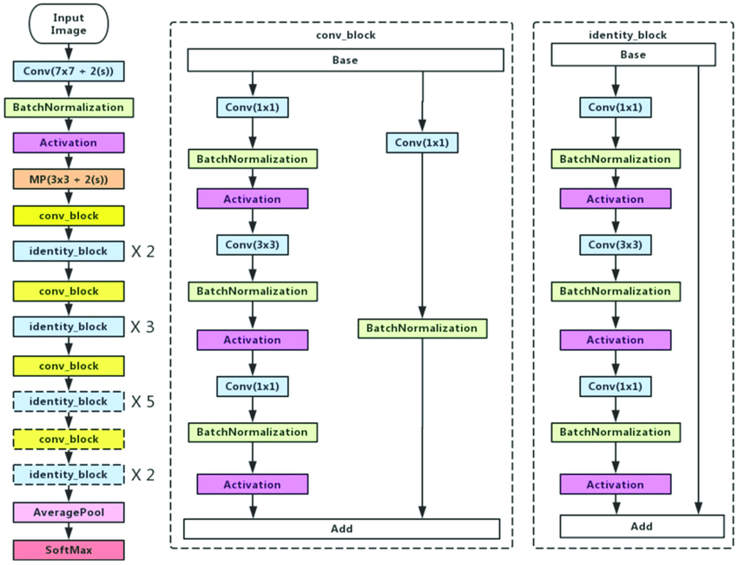
ResNet50
ResNet50 is a Convolutional Neural network with a depth of 50 layers
Network has 224x224 input size
Unlike other networks, ResNet is formed by adding residual values (residual value) to the model, which feeds the next layers (residual block)

Slide 37
Recurrent Neural Networks
RNNs

Slide 38
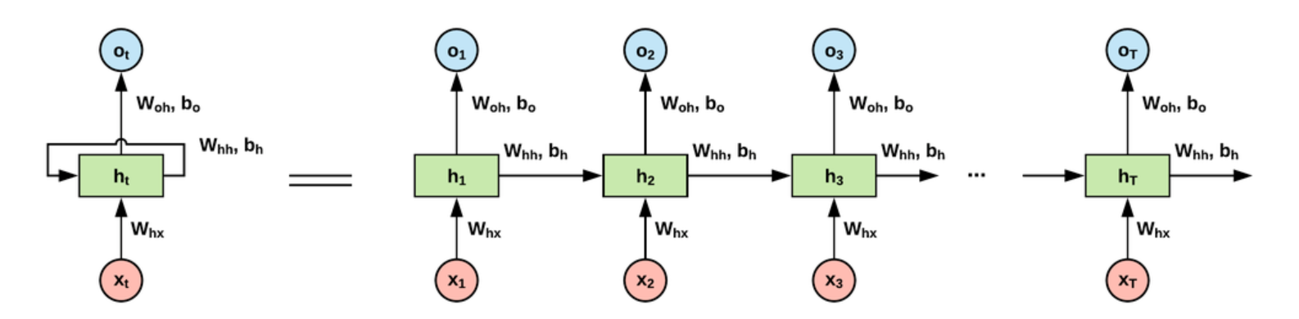
Recurrent Neural Network
RNN is a type of neural network with an internal loop
They process each input they encounter independently from each other and do not keep state information between inputs
With RNN we can feed the output to another neural network and run the image data with arrays
Notes:
mesela siz bir kitap okurken kelime kelime okursunuz ve her yeni kelimeyi okuduğunuzda önceki kelimeyi silmezsiniz. kelimeleri anlayıp, yeni kelimeleri de ekleyip devam eder ve cümle anlama işlemini yaparsınız. RNN buna benzer;

Slide 39
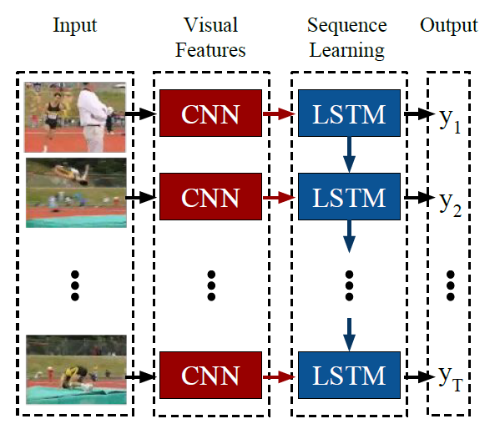
RNN and Computer Vision
To understand actions in videos, it is necessary to analyze multiple images, not just one.
Combining CNNs and RNNs allows us to work on videos.
CNN and RNN architectures may seem to be used to handle different problems, but some data types can be handled by both architectures. For example, RNNs use sequences as input. Sequences can also be videos, which are a series of images.

Slide 40
Recurrent Neural Network
Advantages;
• Possibility to process input of any length
• Model size increasing with input size
• Calculation takes historical information into account
• Weights are shared over time
Disadvantages;
• Calculation is slow
• Difficulty accessing information from a long time ago
• No future input for the current situation can be considered

Slide 41
Other Techniques Used in Convolutional Networks

Slide 42
Data Augmentation

Slide 43
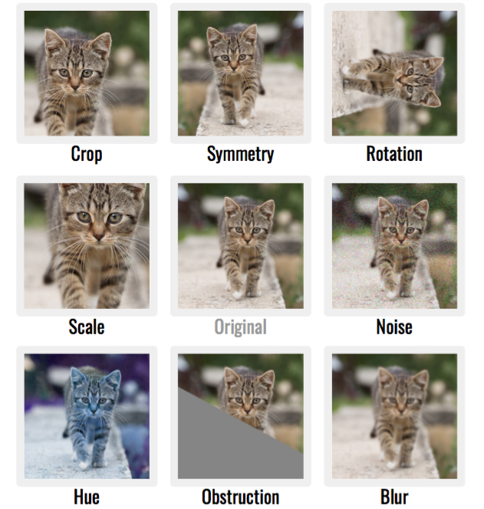
Data Augmentation
Data augmentation in data analysis is a technique used to increase the amount of data by adding slightly modified copies of already existing data or newly created synthetic data from existing data.
It helps avoid overfitting when training a machine learning model.
It is closely related to oversampling in data analysis.

Slide 44
Transfer Learning

Slide 45
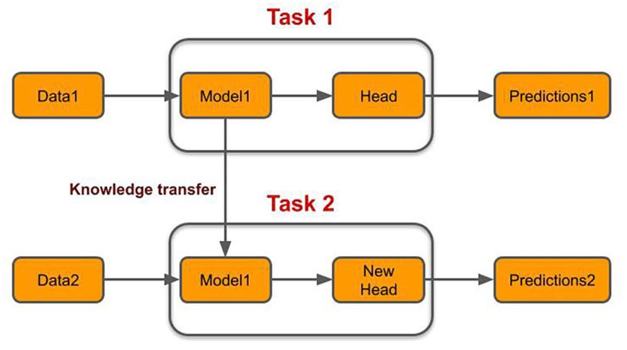
Transfer Learning
Transfer learning consists of taking features learned in a problem and using them on a new, similar problem.
Transfer learning is usually done for tasks where your dataset has too little data to train a full-scale model from scratch.

Slide 46
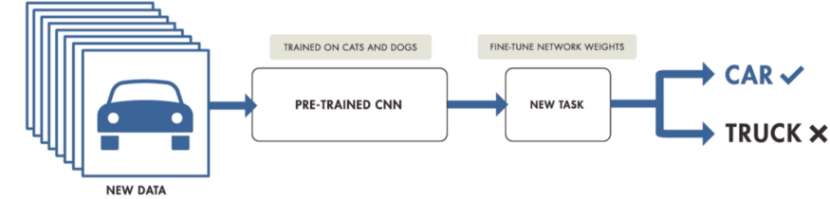
Transfer Learning Workflow
Layers are retrieved from a pre-trained model
Layers are frozen for the purpose of not destroying any information they contain in future training rounds
New, instructable layers are added after the frozen layers. With this process, they will learn to transform old features into predictions on a new dataset
New layers in the dataset are trained

Slide 47
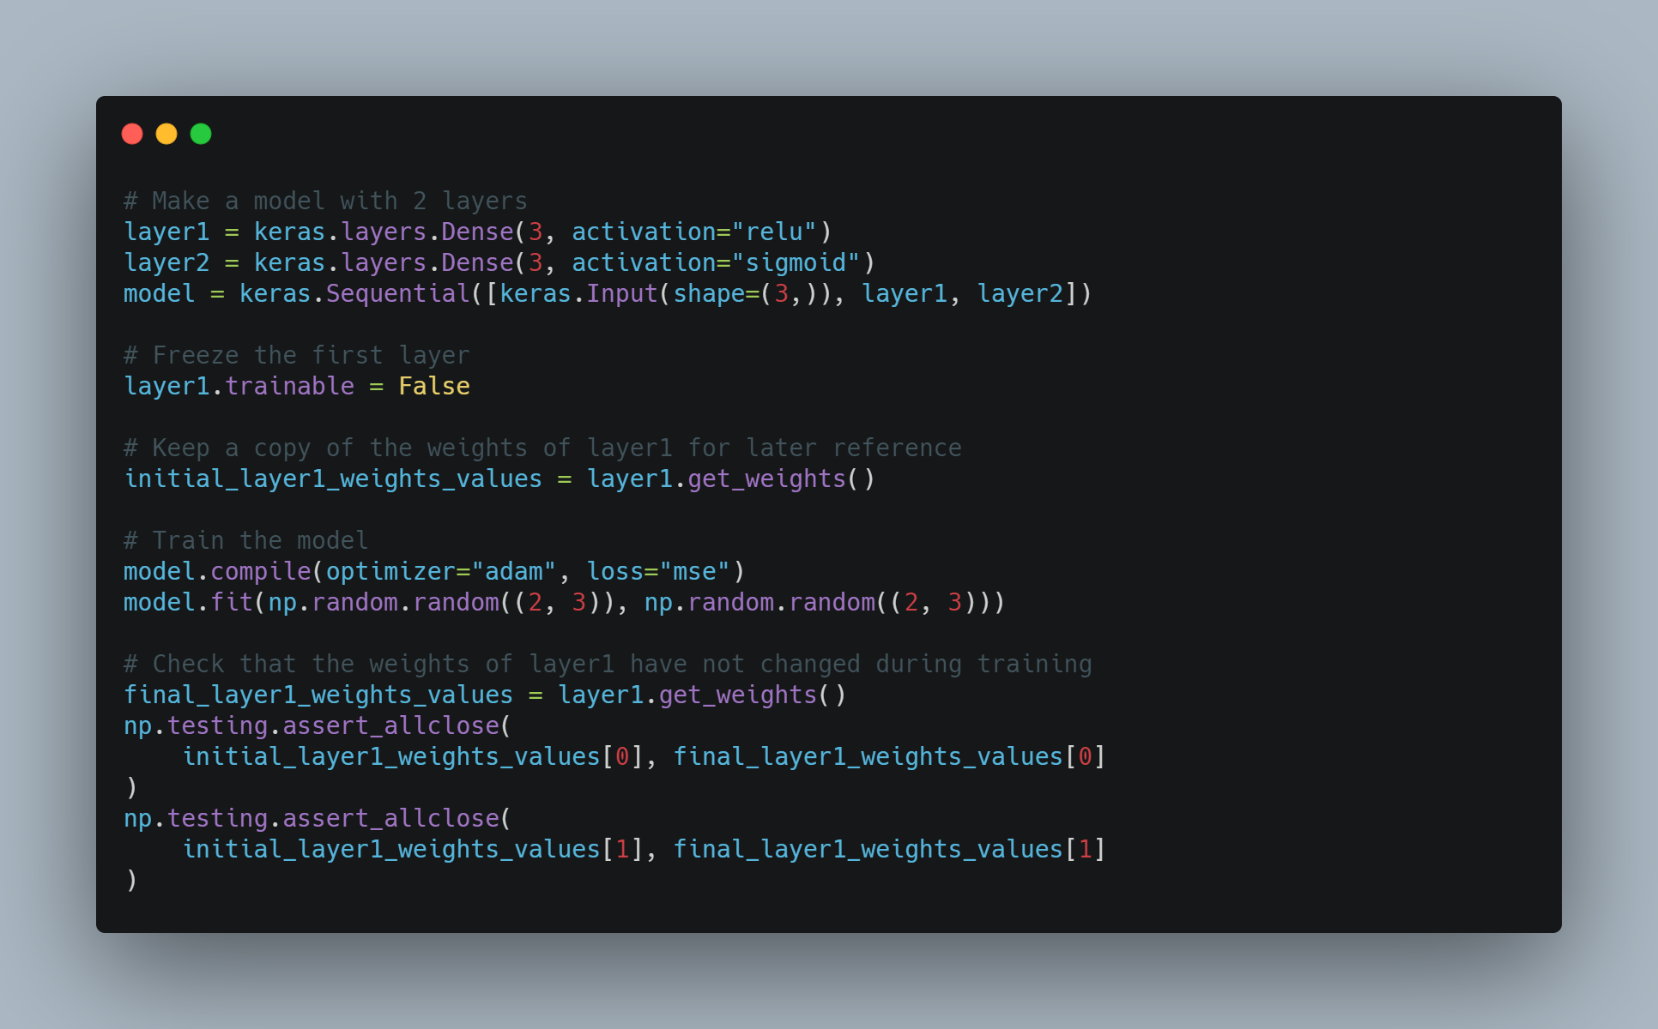
Transfer Learning and Layer Freezing
Using Transfer Learning, you must freeze some layers, the pre-trained ones, and train only those that are added later, and reduce the learning rate to adjust the weights without confusing their meaning for the network.
Freezing a layer prevents its weight from being changed. This technique is often used in transfer learning where the base model (trained on another dataset) is frozen.
Notes:
katmnalarda ağırlıklar bizim için neden önemli

Slide 48
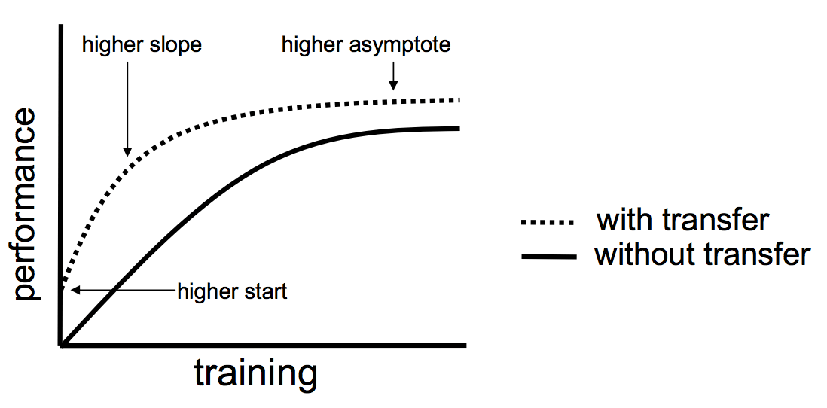
Transfer Learning and Its Benefits
Better initial model: In other types of learning, you have to build a model without any knowledge. Transfer learning offers a better starting point and can perform tasks at some levels without even needing training.
Higher learning rate: Transfer learning offers a higher learning rate during training, as the problem has already been trained for a similar task.
Higher accuracy after training: With a better starting point and higher learning rate, transfer learning provides a machine learning model that converges at a higher performance level and provides more accurate output.
Faster training: Learning can achieve desired performance faster than traditional learning methods as it utilizes a pre-trained model.

Slide 49
One-shot Learning

Slide 50
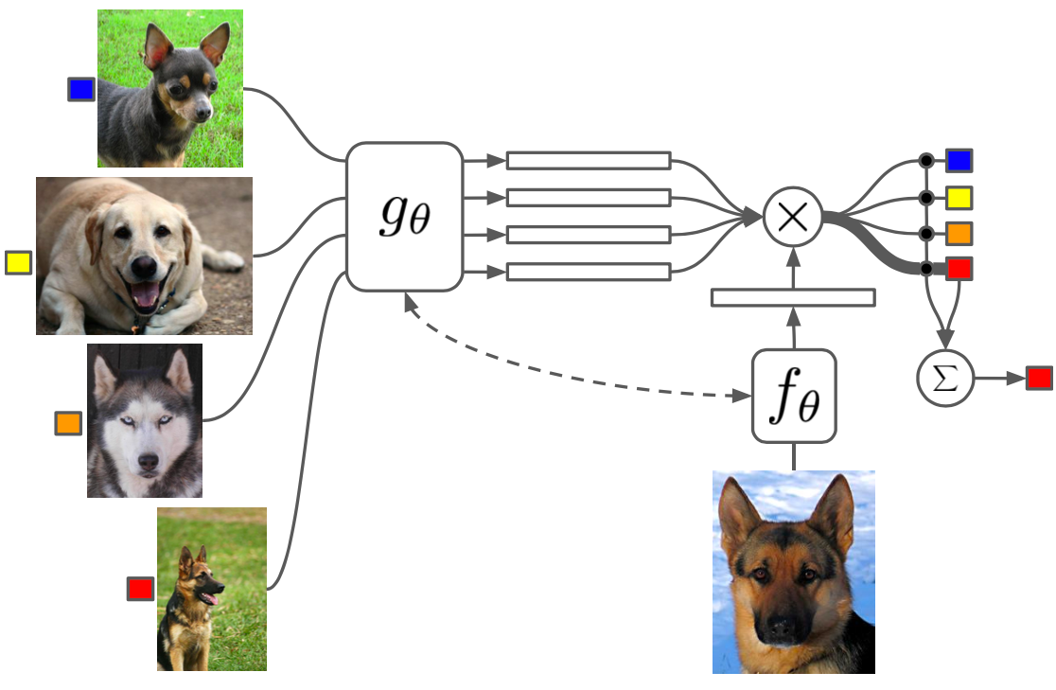
One-shot Learning
One-shot learning is used to construct a model in which one sample (or very few samples) is given for each class.
One-Shot Learning mostly deals with object classification problem.
While most machine learning-based object classification algorithms require training on hundreds of images and very large datasets, one-shot learning aims to learn information about object categories from one or just a few training examples.

Slide 51
Object Detection

Slide 52
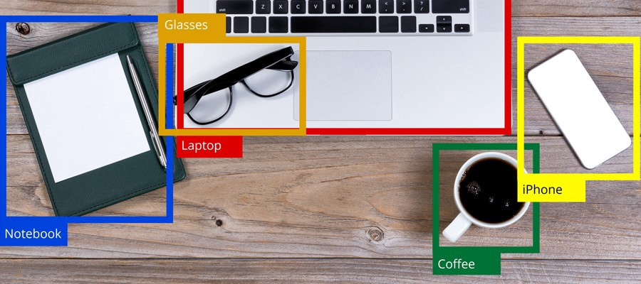
What is Object Detection?
By doing object detection one can find the presence of bounding box objects in an image and the types or classes of positioned objects.
Input: An image containing one or more objects, such as a photograph.
Output: One or more bounding boxes and a class label for each bounding box.

Slide 53
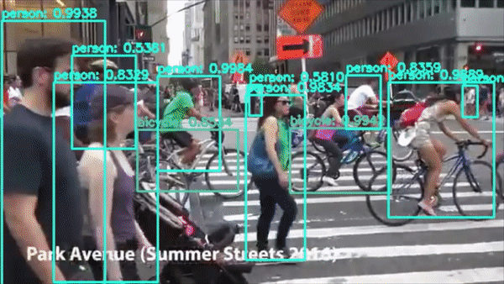
Object Detection and Usage Areas
Advertising: Brand & Logo detection, Human Behavior Analysis
Autonomous Driving: Pedestrian Detection, Traffic Light Detection
Defense & Space Exploration: Remote Sensing Target Detection
Healthcare: Medical Imaging & Diagnostics
Robotic: Robot Vision & Manipulation
Security: Video Surveillance, Traffic Monitoring

Slide 54
Object Detection Architectures

Slide 55
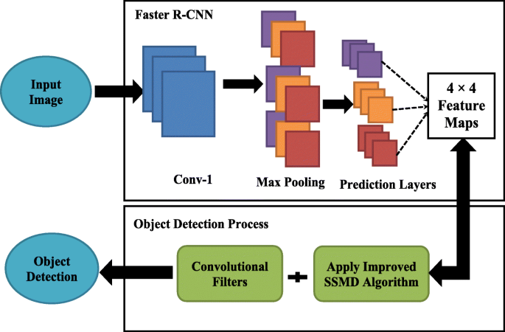
Object Detection Architectures
R-CNN
Fast R-CNN
Faster R-CNN
YOLO
SSD
RefineNet
RefineDet

Slide 56

Faster R-CNN
Creates regions using the Region Propasal Network algorithm
Treats each zone assuming there are objects and assigns neutral points to each zone
While performing these operations, it looks at criteria such as density, color, pixel order
Extracts Feature Map using ReLu activation function

Slide 57

YOLO (You Only Look Once)
The YOLO algorithm, which stands for "You Only Look Once"; is a fast algorithm that can detect objects in one go
The YOLO algorithm scans the image by looking through grids
Can identify objects and object coordinates simultaneously and at once

Slide 58

SSD - Single Shot Detector
Extracts a feature map and then applies Convolution filters to detect objects
The reason for high accuracy detection on SSD is the use of multiple boxes with different aspect ratios
Bounding box includes a descending amount of shaped convolution filters to predict categories of objects at their locations
Notes:
farklı en boy oranlarına sahip birden çok kutu kullanılmasıdır

Slide 59
Object Recognition Datasets

Slide 60


COCO
COCO is a large-scale object detection, segmentation and visual dataset.
330K images (>200K tagged)
1.5 million object instances
80 categories of objects
91 item categories
Uses JSON format while keeping data

Slide 61


Pascal VOC()
It is a dataset used for image processing and object detection
Contains image filename, label and bounding box coordinate information
2GB main image comes in 1.9GB metadata size
Data is kept in XML format during transactions

Slide 62
12 Articles to Understand Object Detection
OverFeat: Integrated Recognition, Localization and Detection using Convolutional Networks (2013)
Region-Based Convolutional Networks for Accurate Object Detection and Segmentation
Fast R-CNN (2015)
Faster R-CNN: Towards Real-Time Object Detection with Region Proposal Networks
You Only Look Once: Uniﬁed, Real-Time Object Detection
SSD: Single Shot MultiBox Detector
Feature Pyramid Networks for Object Detection
YOLO9000: Better, Faster, Stronger
Focal Loss for Dense Object Detection (RetinaNet)
YOLOv3: An Incremental Improvement
Objects As Points(CenterNet)
EfficientDet: Scalable and Efficient Object Detection
Kaynak: https://towardsdatascience.com/12-papers-you-should-read-to-understand-object-detection-in-the-deep-learning-era-3390d4a28891

Slide 63
Image Classification

Slide 64


Slide 65

Image Classification & Localization
Image classification is a task in which an image is divided into one or more classes according to the task.
Input: a picture
Output: one or more class(es)
Image/Object localization; It is a regression problem in which the output operates with x,y coordinates around the object of interest by drawing bounding boxes.

Slide 66


MNIST
28x28 pixels
60.000 Train Images
10.000 Test Veri Seti
Handwritten public dataset of 70,000 images for all digits 0-9

Slide 67


ImageNet
More than 14 million images
Approximate size is 150 GB
Each of the images has multiple bounding boxes and corresponding class labels
It is a free and publicly available data set

Slide 68

CIFAR-10
32x32 pixels
50.000 train images
10.000 test images
10 different class and 6000 image for each class
On the right is a portion of a randomly distributed set of images for 10 classes.

Slide 69
Colab Time!

